Slide 1

GOVERNMENT POLYTECHIC, AWASARI (Kh)
CERTIFICATE
This is to certify that
Name of Students | Enrollment No
Sanket Gaikawad | 1810510271
Pritee Kodre | 1610510163
Shubham Adak | 1810510238
Aditya Patil | 1810510275

Slide 2
Introduction
This system will recommend movie on k-means clustering algorithm.
This is movie recommendation system. The main aim of this project to develop website that will allow to watch movie this website is mainly built on reacts framework.
The mainly used languages are html, css, bootstrap, java , react js languages.
This system will overcome existing content providing platforms by providing watch time regulations.
The database of the system can be easily maintained and can be extend in future for up-coming content.
This system totally automated and there is requirement of provisions, the only task in system will add more content, regular the content and check whether content is violating content policy.

Slide 3
Literature survey
Sr. No. | Type of document And Publisher | Topic/Conclusion of ppt | Author Name | Retrieval for Our Project
1 | IEEE | This paper designs and develops an Movie Recommendation system for undergraduates’ | Hongfu Wang | Responsibilities of the four categories of users, workflow, design ideas, and discusses some design methods to enhance the security of the system.
2 | IEEE | In this research ppt they studied about the exciting used and new system developed | Haidarali Nadir Shah | Survey of all such web-based project management system and proposes a system
3 | IEEE | In this research ppt they studied the various Information about Movie Recommendation | Faisal Latif Khan | Many techniques for automating the project management system by providing features such as real-time.

Slide 4
Problem statement
In this project, we have designed a website that uses different techniques for generating recommendations.

Slide 5
objective
General Objective:
now a days we all know that every month there is a release of minimum of 2 to 3 the movies from Bollywood, Tollywood industries
So our project will suggest the best movies base on the ratings and the overviews of the movies.
Specific Objective:
No need to get information about a particular movie from google or from any thing from outside
Using our project, the user/client can easily find out the best movies
Saving Time

Slide 6
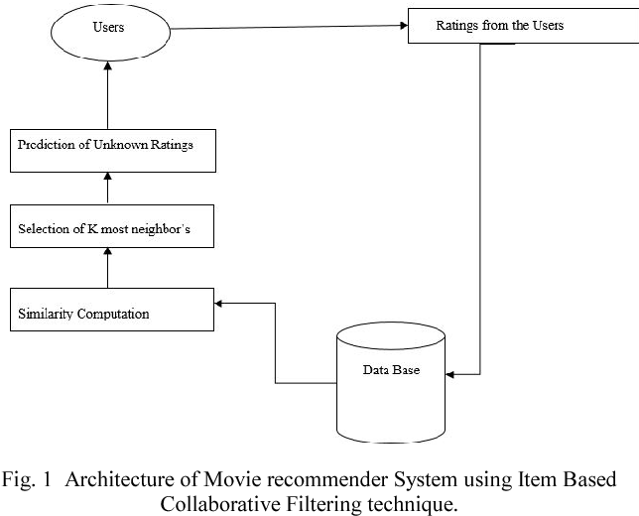
System architecture

Slide 7
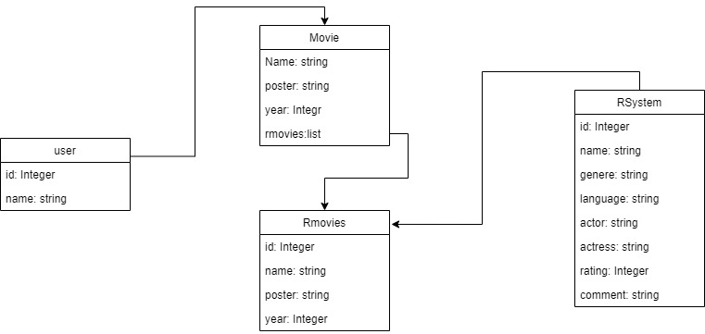
UML Modeling (class diagram)

Slide 8
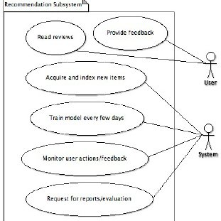
Use case diagram

Slide 9
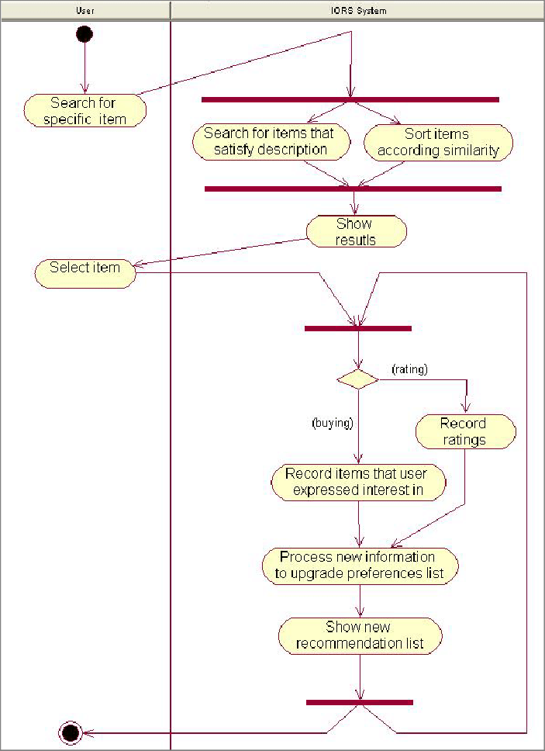
Activity Diagram

Slide 10
Application
Recommendation system has become increasingly popular in recent years, which utilizes in a variety of areas including movies, music, news and products in general.
Recommendation system produce a ranked list of items on which a user might be interested, in the context of his current choice of an item.
Subclass of information filtering system that seek to predict the ‘preference’ that user would give to them.
Helps deciding in what to wear, what to buy, what stocks to purchase, What to see etc.
Applied in variety of applications like movie, books, Music, Shopping.
Recommendation system has mainly two elements item and User.

Slide 11
Conclusion
From this project we can conclude that it we provide quality contents and recommend the contents according to user interest.

Slide 12
References
https://www.irjet.net/archives/V7/i7/IRJET-V7I7199.pdf (movierecommendation system)

Slide 13
Thank you…

